Slide 1
H7 avian influenza (bird flu) 2025 stakeholder communications pack
February 2025
Notes:
Jess

Slide 2
WHAT’S THE PURPOSE OF THIS PACK?
Agriculture Victoria is responding to detections of H7 avian influenza (bird flu) near Euroa.
We would greatly appreciate your help in sharing information with your audiences and networks. We have developed this stakeholder pack to assist you in this process and ensure there is an aligned and clear strategy across communication channels.
How you can help:
Share the materials in this pack with your community and audiences via social media, website, email and other digital platforms.
What’s included?
Key information and messages
Social media copies
Newsletter blurb
Factsheets.
Notes:
Jess

Slide 3
KEY MESSAGES: THE CURRENT SITUATION
Two commercial poultry farms in northern Victoria have tested positive for high pathogenicity H7N8 avian influenza (bird flu).
CSIRO’s Australian Centre for Disease Preparedness (ACDP) at Geelong has confirmed high pathogenicity H7N8 at both farms.
This is a new outbreak and is not related to the 2024 outbreaks in Victoria, New South Wales and Australian Capital Territory, which were eradicated.
The strain detected is also different from the H5 bird flu strain that is impacting other parts of the world.
Agriculture Victoria is working to rapidly contain the outbreak and minimise its impact. We are working closely with impacted farmers and industry throughout the response.
The infected farms have been quarantined under the Livestock Disease Control Act (1994) and we’ve commenced activities to eradicate the virus. This will include humanely destroying all poultry on the infected properties, strict movement controls in the surrounding area, and intensive surveillance to detect whether there has been further spread.
Poultry farmers, backyard chicken and bird owners are urged to report any cases of unexplained bird deaths to the Emergency Animal Disease (EAD) hotline on 1800 675 888.
For the latest information, including movement restrictions and permits for the control and restricted areas, visit agriculture.vic.gov.au/avian influenza or call the VicEmergency Hotline on 1800 226 226.

Slide 4
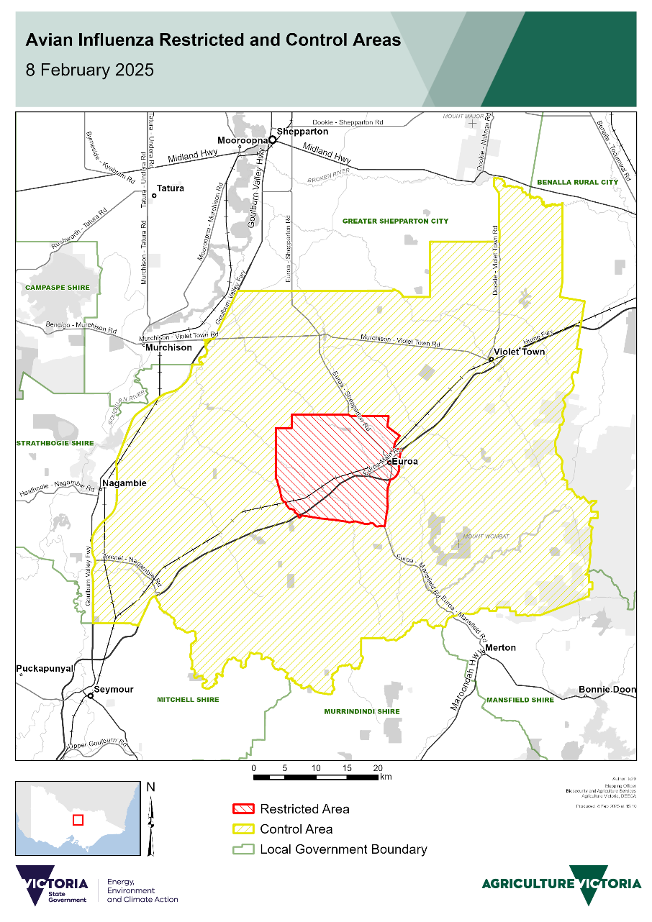
KEY MESSAGES: MOVEMENT CONTROLS AND PERMITS (1/2)
Movement controls are used to reduce the spread of disease by preventing the movement of infected animals, products and other materials, and by allowing or permitting movements that pose a minimal risk.
Movement controls are applied in accordance with a nationally agreed response strategy and are based on the level of risk which may change over the course of a disease outbreak.
Movement controls have been put in place for the townships and areas surrounding Euroa, Violet Town, Longwood, Ruffy, Avenel and Strathbogie.
A control area is in place in the Strathbogie Shire in the area to the east of the Goulburn Valley Highway, and a restricted area is approximately a 5 kilometres radius of the impacted properties at Euroa.
All movements of birds and bird products (including eggs, manure, meat and bird carcases) into, within or out of the restricted and control areas are prohibited, unless under a permit.
Exemptions are in place that allow vehicles transporting birds, bird products (including eggs and manure), bird feed and husbandry equipment to travel along the Hume Freeway, providing the vehicles do not stop in the restricted or control areas and do not deviate from the Hume Freeway.

Slide 5
KEY MESSAGES: MOVEMENT CONTROLS AND PERMITS (2/2)
If you have pet birds or backyard poultry in the restricted or control areas, you must observe all official controls. If you are in the restricted or control areas, you cannot move your birds, products (including eggs and manure), or husbandry equipment without a permit. This includes prohibiting selling or giving away eggs without a permit. If you need a permit, please use the Permits portal on the Agriculture Victoria website.
All pigeon racing, bird shows and bird sales are prohibited in the control and restricted areas, and should be postponed until further notice, but these activities can continue across Victoria outside of these areas.
A housing requirement is in place for poultry owners with 50 or more birds in the restricted area. The housing requirement is not in place for the wider control area, or for bird owners with less than 50 birds, however they must still follow all movement restrictions.
If you have poultry in the restricted area, you might receive more regular check-ins from Agriculture Victoria as we monitor the health of poultry in the area, and understand disease spread and risks.

Slide 6
KEY MESSAGES: AVIAN INFLUENZA (BIRD FLU)
Bird flu is a viral disease of birds found globally. It is a highly contagious disease that can affect most birds.
Bird flu is a notifiable disease. This means that legally you must tell us if you suspect or know of the presence of bird flu, no matter the strain, in any birds without delay. You can do this by immediately calling one of the following:
the VicEmergency hotline on 1800 226 226
your local vet
the 24-hour Emergency Animal Disease Hotline 1800 675 888.
Clinical signs in birds
The most important sign to be aware of and report immediately is sudden death.
Other signs associated with bird flu can include: respiratory signs (noisy or rapid breathing, coughing, sneezing, increased nasal secretions), conjunctivitis, swelling of the head, purple discolouration of the comb and wattles, rapid decrease in feed and water intake, decreased egg production, ruffled feathers, depression, closed eyes, diarrhoea, nervous signs (twisted neck, inability to stay upright, inability to fly, uncoordinated movement, walking or swimming in circles, partial or full paralysis).
Human health
H7 strain of bird flu poses a low risk to the public as it rarely affects humans unless there is direct and close contact with sick birds.
Eggs and poultry products from the supermarkets do not pose a risk and are safe to eat.
More information: betterhealth.vic.gov.au/health/conditionsandtreatments/bird-flu-avian-influenza

Slide 7
KEY MESSAGES: WHAT CAN I DO TO PROTECT MY BIRDS?
Bird flu can be spread by the movement of live birds, bird products, people and equipment.
It’s important that everyone from commercial producers to backyard chicken owners follow good biosecurity practices to help reduce the spread of disease.
You should do everything you can to ensure your birds are not in contact with wild birds. Place all feed and water sources under cover where wild birds cannot access them.
Your birds should drink the same water as you — town water or tank water. Keep them away from potentially contaminated water sources such as streams, dams, ponds and even large puddles.
Keep sheds, yards and aviaries clean, including equipment. Clean thoroughly with a detergent before applying a disinfectant. Frequently replace nesting materials.
Information about biosecurity for bird owners is on the Agriculture Victoria website at agriculture.vic.gov.au/avianinfluenza
Poultry shows and pet birds
Poultry shows can continue to operate outside of the control and restricted areas, poultry shows are prohibited inside the restricted and control areas. No birds or bird products including eggs, feathers and meat should be moved from within the control or restricted area to attend poultry shows, or moved from shows into a control or restricted area.
Agriculture Victoria strongly encourages stringent biosecurity and hygiene practices are followed at all poultry shows operating outside the control and restricted areas.
Bird flu in pet birds such as budgies, canaries and other caged birds has not been a feature of previous outbreaks in Victoria. However, all species of birds are considered susceptible, and we encourage pet bird owners to keep their birds under cover and separate from wild birds.

Slide 8
SOCIAL MEDIA POST:
Suggested copy:
Suggested image:
H7 bird flu has been confirmed at 2 commercial poultry farms near Euroa.
This is a new outbreak and is not related to the 2024 outbreaks in Victoria, New South Wales or in the Australian Capital Territory, which were eradicated.
The strain detected is also different from the H5N1 avian influenza strain that is impacting other parts of the world.
You can help by reporting sick or dead birds to the VicEmergency Hotline on 1800 226 226.
For the latest information, visit agriculture.vic.gov.au/avianinfluenza .
Click here to download image
Notes:
Jess

Slide 9
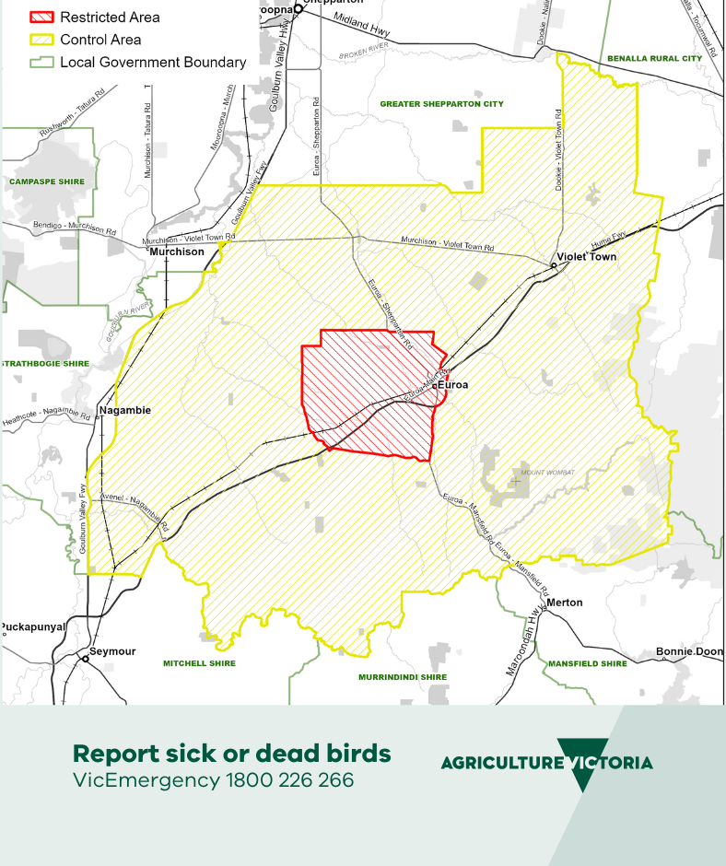
SOCIAL MEDIA POST:
Suggested image:
Suggested copy:
Movement controls for poultry and products are now in place for the area across the Strathbogie Shire to the east of the Goulburn Valley Freeway.
All movements of birds and bird products (including eggs, meat and bird carcases) into, within or out of the restricted and control areas are prohibited unless under a permit.
Exemptions are in place that allow vehicles transporting birds, bird products (including eggs and manure), bird feed and husbandry equipment to travel along the Hume Freeway, providing the vehicles do not stop in the restricted or control areas and do not deviate from the Hume Freeway.
Need to apply for a permit? Visit agriculture.vic.gov.au/avianinfluenza
Click here to download image
Notes:
Jess

Slide 10
SOCIAL MEDIA POST:
Suggested image:
Suggested copy:
A housing requirement is now in place for poultry owners with 50 or more birds in the restricted area.
The housing requirement is not in place for the wider control area, or for bird owners with less than 50 birds, however they must still follow all other movement restrictions.
For the latest information, visit agriculture.vic.gov.au/avianinfluenza or call the VicEmergency Hotline on 1800 226 226.
Click here to download image
Notes:
Jess

Slide 11
SOCIAL MEDIA POST:
Suggested image:
Suggested copy:
If you have pet birds or backyard poultry in the restricted or control areas, you must observe all official controls. You cannot move your birds, products (including eggs and manure), or husbandry equipment without a permit.
If you need a permit, please use the permits portal on the Agriculture Victoria website.
For more information, visit agriculture.vic.gov.au/avianinfluenza
Click here to download image
Notes:
Jess

Slide 12
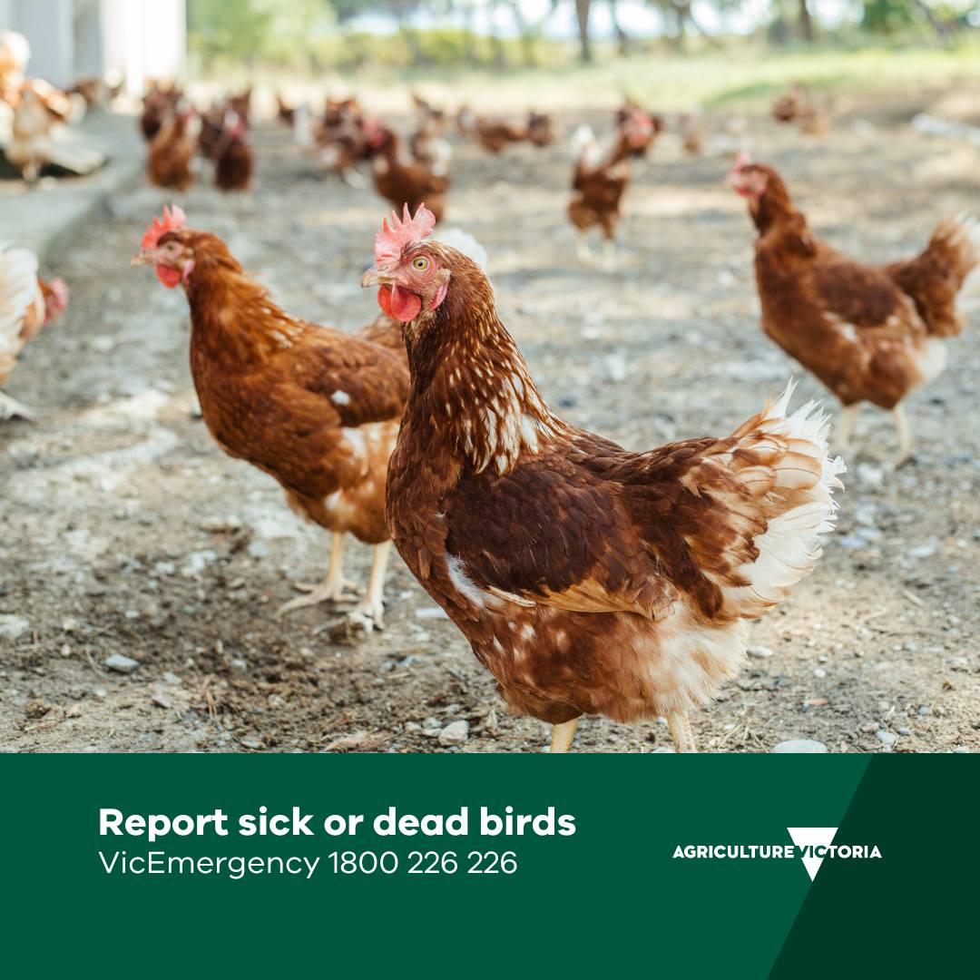
SOCIAL MEDIA POST:
Suggested copy:
Suggested image:
Attention poultry farmers, backyard chicken and bird owners - remember to regularly check your birds!
If you suspect your birds are sick, contact your local vet or call the all-hours Emergency Animal Disease Hotline on 1800 675 888.
For more information about avian influenza, visit agriculture.vic.gov.au/avianinfluenza
Click here to download image

Slide 13
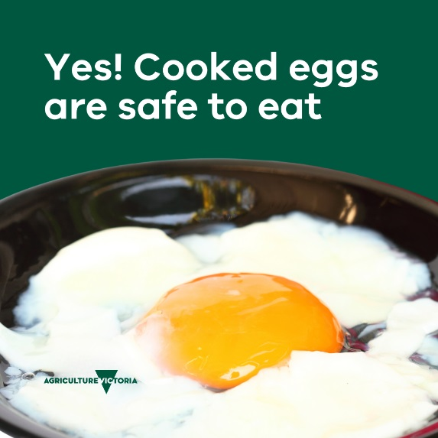
SOCIAL MEDIA POST:
Suggested copy:
Suggested image:
Can I still eat eggs?
Eggs and poultry products from the supermarkets do not pose a risk and are safe to eat.
Victorian supermarkets stock local and interstate poultry and egg products and are continuing to maintain supply for their customers.
For more information, visit agriculture.vic.gov.au/avianinfluenza
Click here to download image
Notes:
Jess

Slide 14
NEWSLETTER BLURB
Two commercial poultry farms in northern Victoria have tested positive for high pathogenicity H7N8 avian influenza (bird flu).
Agriculture Victoria is working to rapidly contain the outbreak and minimise its impact.
A restricted area with an approximate 5 km radius and has been placed around the infected properties within a wider control area in place across the Strathbogie Shire to the east of the Goulburn Valley Freeway. All movements of birds and bird products (including eggs, manure, meat and bird carcases) into, within or out of the restricted and control areas are prohibited unless under a permit.
Exemptions are in place that allow vehicles transporting birds, bird products (including eggs and manure), bird feed and husbandry equipment to travel along the Hume Freeway, providing the vehicles do not stop in the restricted or control areas and do not deviate from the Hume Freeway.
A housing requirement is now in place for bird owners with 50 or more birds in the restricted area. The housing requirement is not in place for the wider control area, or for bird owners with less than 50 birds, however they must still follow all other movement restrictions.
Poultry farmers, backyard chicken and bird owners should immediately report any cases of unexplained bird deaths to the Emergency Animal Disease (EAD) hotline on 1800 675 888. For the latest information, including movement restrictions and permits for the control and restricted areas, visit agriculture.vic.gov.au/avianinfluenza or call the VicEmergency Hotline on 1800 226 226.
Notes:
Jess

Slide 15
More information
Current situation: agriculture.vic.gov.au/avianinfluenza
Keeping backyard poultry: agriculture.vic.gov.au/biosecurity/animal-diseases/poultry-diseases/keeping-backyard-poultry
About avian influenza: agriculture.vic.gov.au/biosecurity/animal-diseases/poultry-diseases/avian-influenza-bird-flu#h2-3
Avian influenza factsheet: agriculture.vic.gov.au/biosecurity/animal-diseases/poultry-diseases/avian-influenza-bird-flu/avian-influenza-factsheet
Follow Agriculture Victoria on Facebook or X.
Notes:
Jess

Slide 16
Thank you for your support.
For more information visit agriculture.vic.gov.au/avianinfluenza
Notes:
Jess

